Slide 1
Scratch
Flappy Bird – Part 1

Slide 2
Remember the Scratch URL
Our URL to find our workspace:
www.scratch.mit.edu

Slide 3
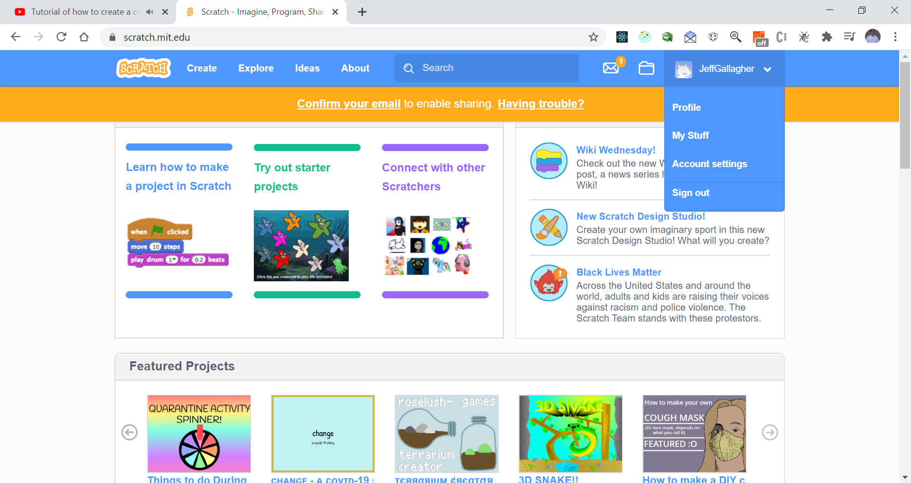
Retrieve your project – where to find it
My Stuff

Slide 4
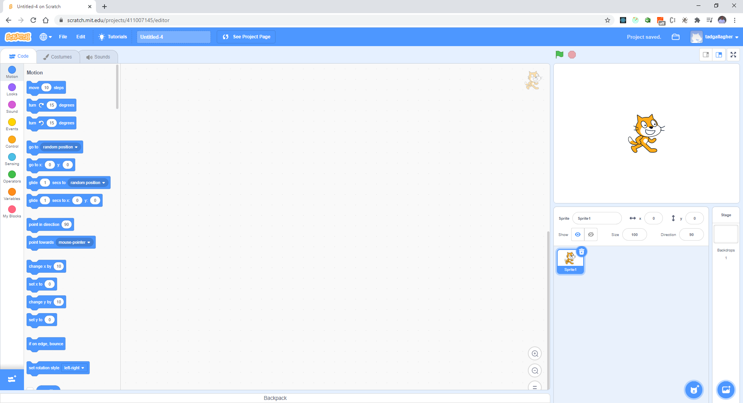
Create a New Project – select create button Erase Scratchy Next

Slide 5
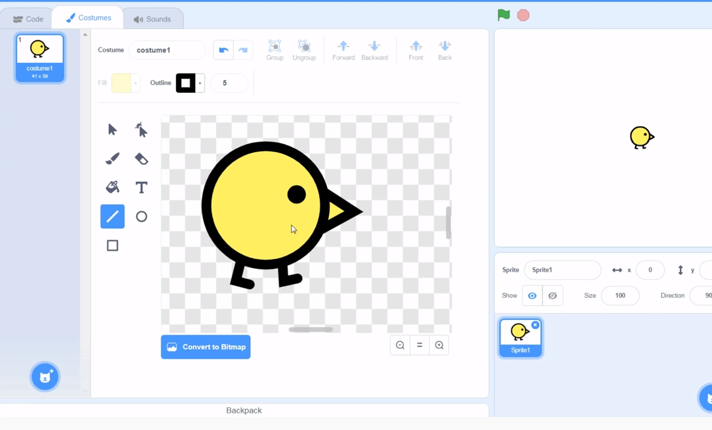
Create the Bird – Draw it

Slide 6
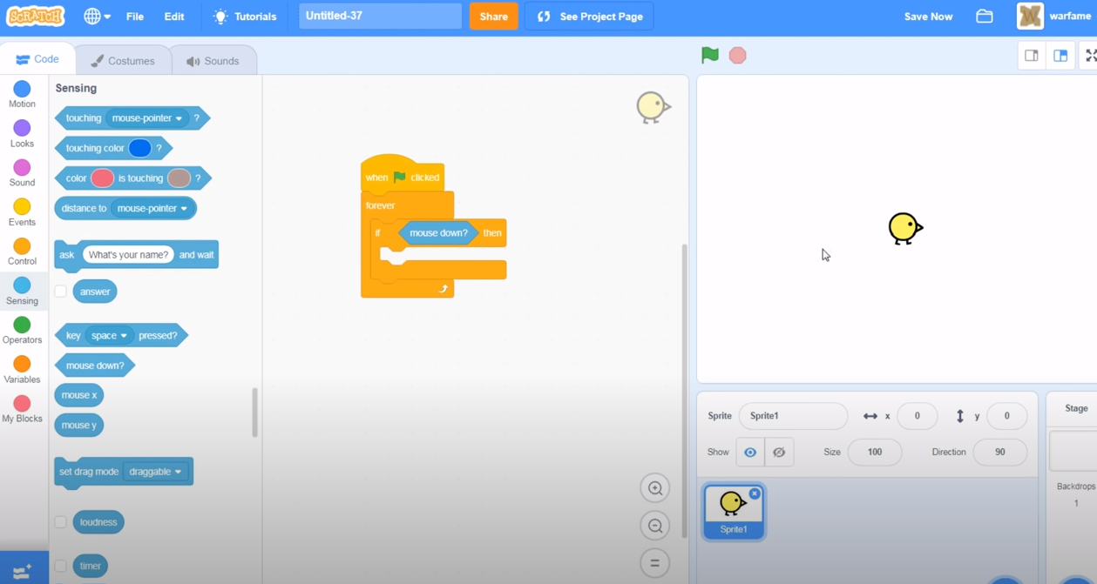
Let’s start coding the bird Jump when down mouse is pressed.

Slide 7
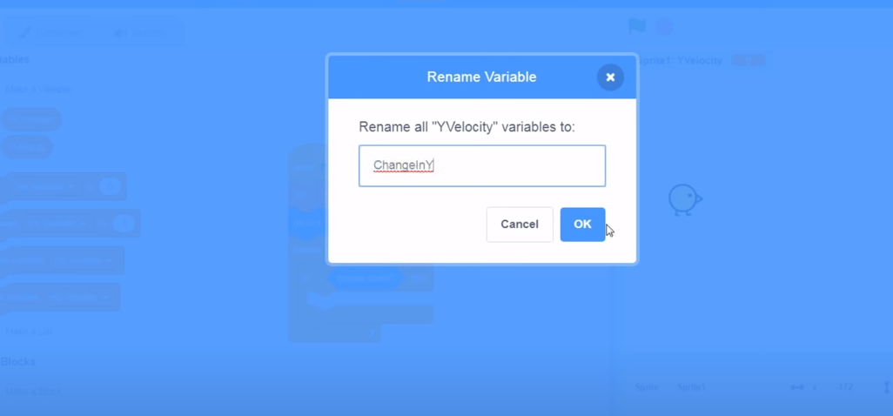
Create a variable for the bird jumps (up and down speed of the bird)

Slide 8
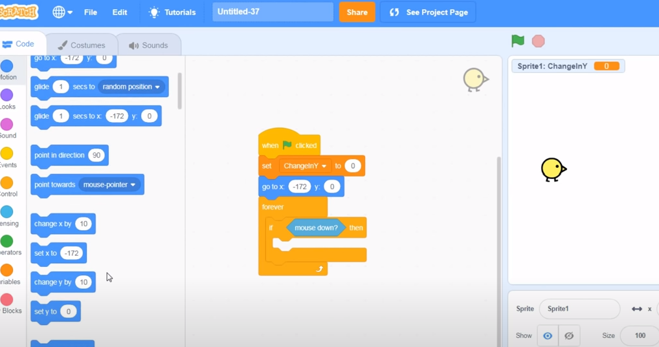
Initialize variables and positions

Slide 9
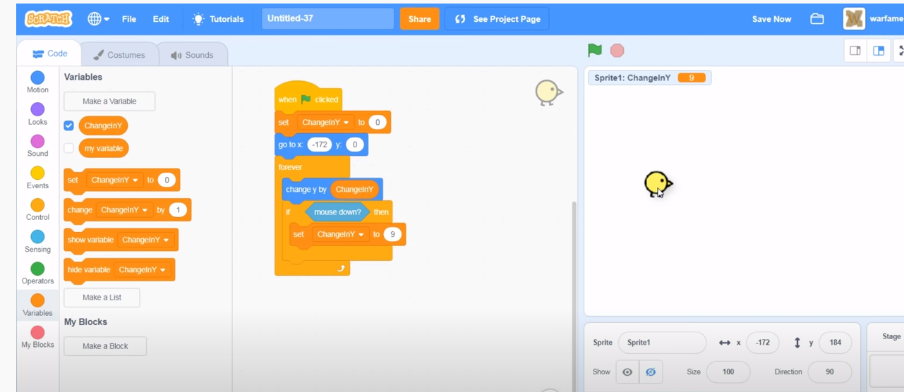
Change the position of the bird by the change in Y

Slide 10
Test your work
Press the mouse down – what happens?

Slide 11
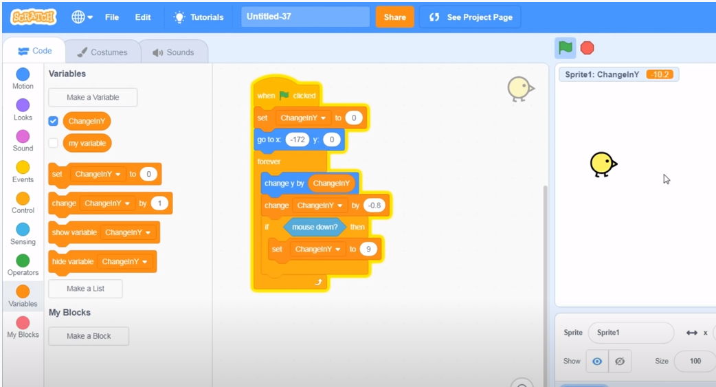
Add gravity – bird falls when it jumps

Slide 12
Test your work again!
Does it go up and down?

Slide 13
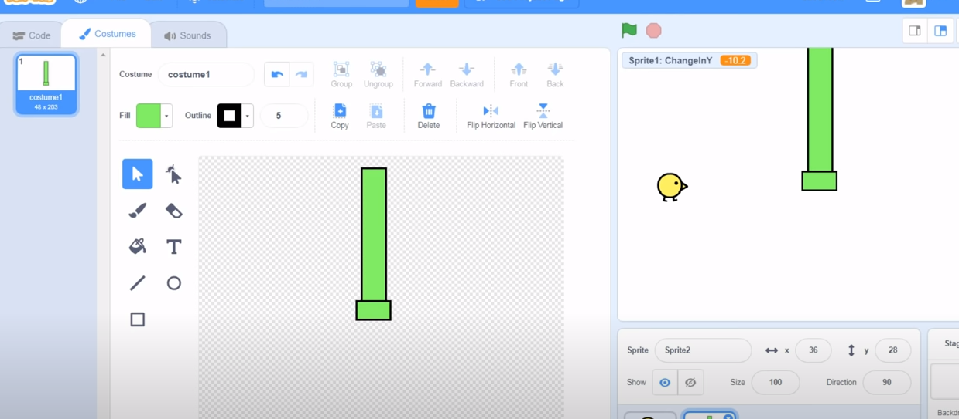
Now let’s create the pipes – new sprite (top pipe)

Slide 14
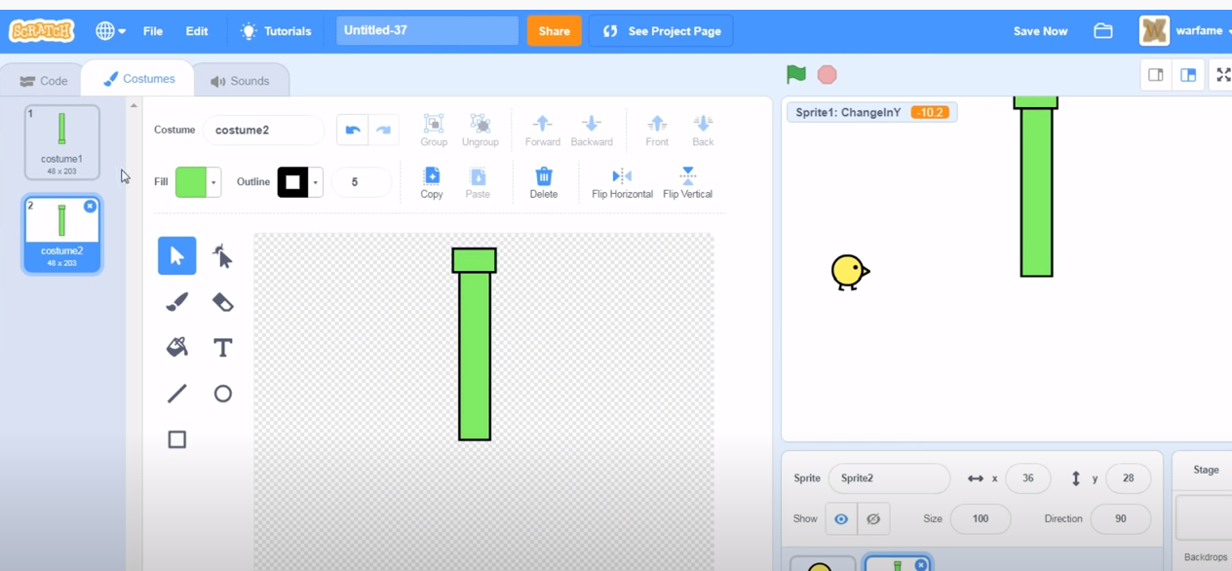
Create bottom pipe – duplicate and flip

Slide 15
Name your sprites accordingly
Good practice to use good naming conventions
Bottom Pipe
Top Pipe

Slide 16
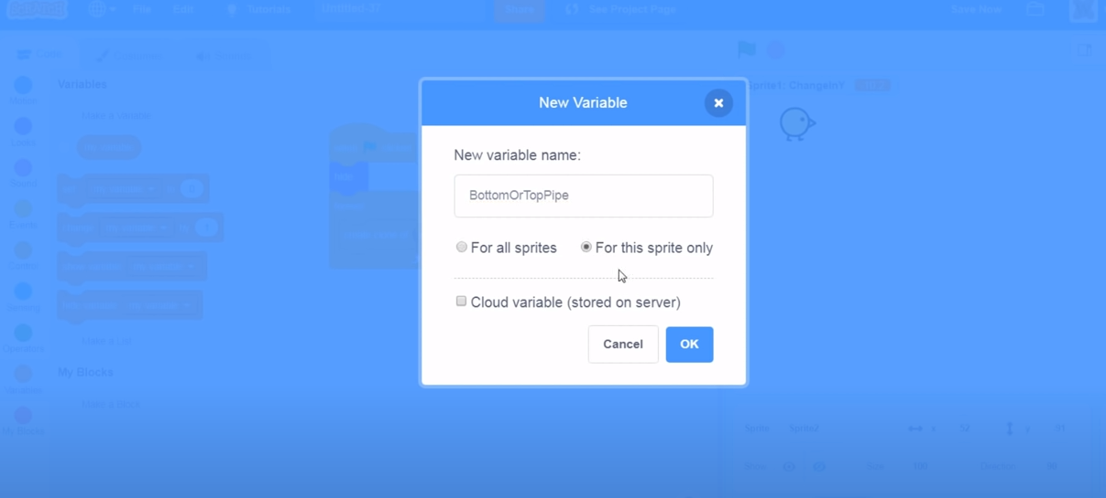
Create a variable – BottomOrTopPipe

Slide 17
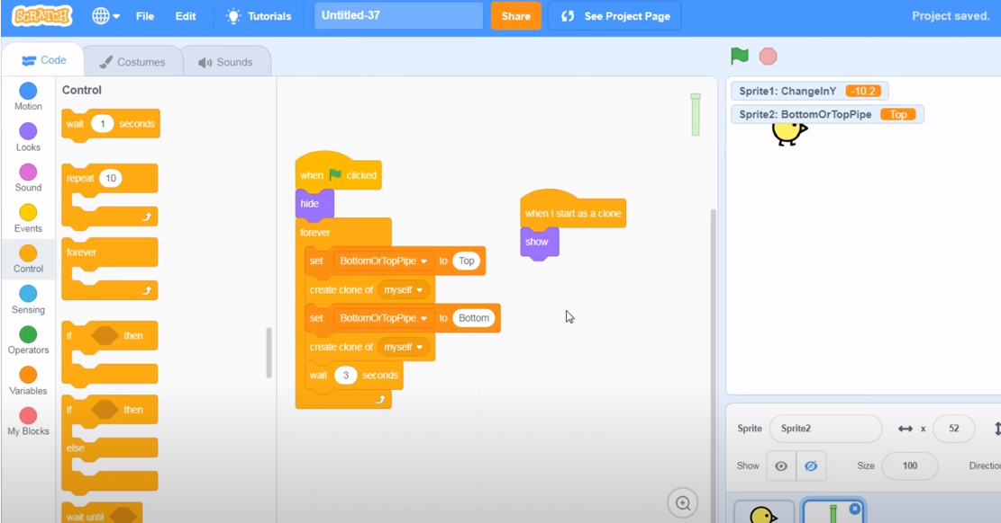
Code the Pipes (hide sprite)

Slide 18
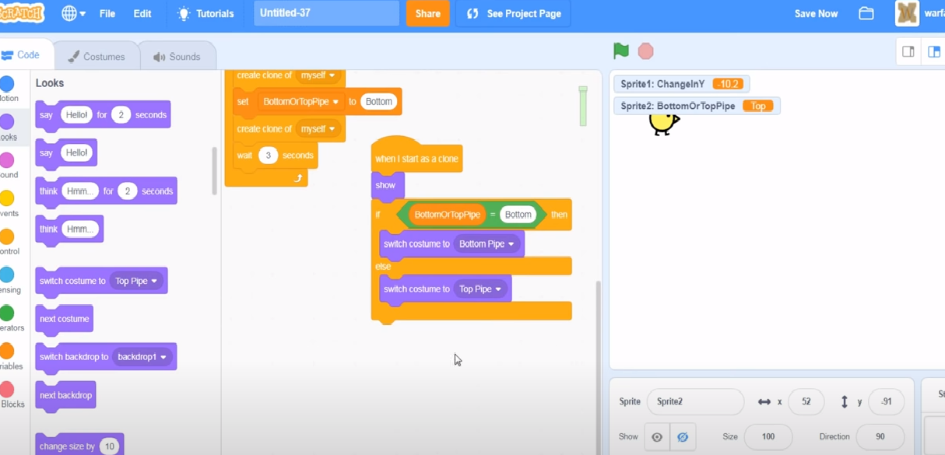
Add Pipe cloning

Slide 19
Test your work
It should not work, but verify your pipes are cloned

Slide 20
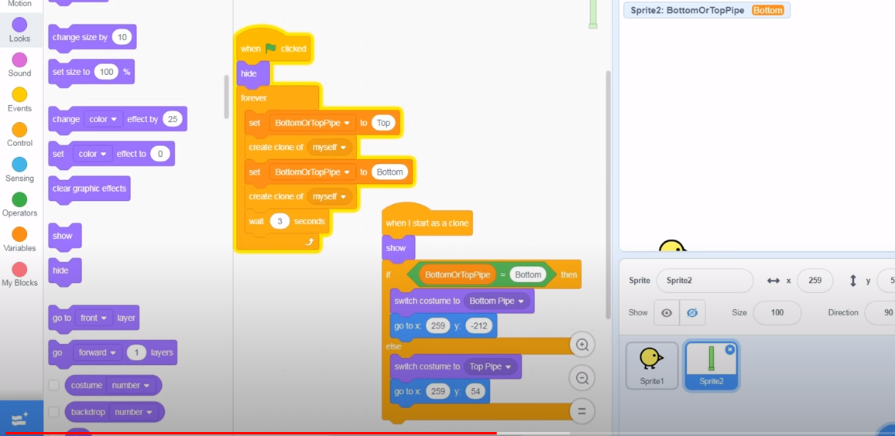
Position the Pipes

Slide 21
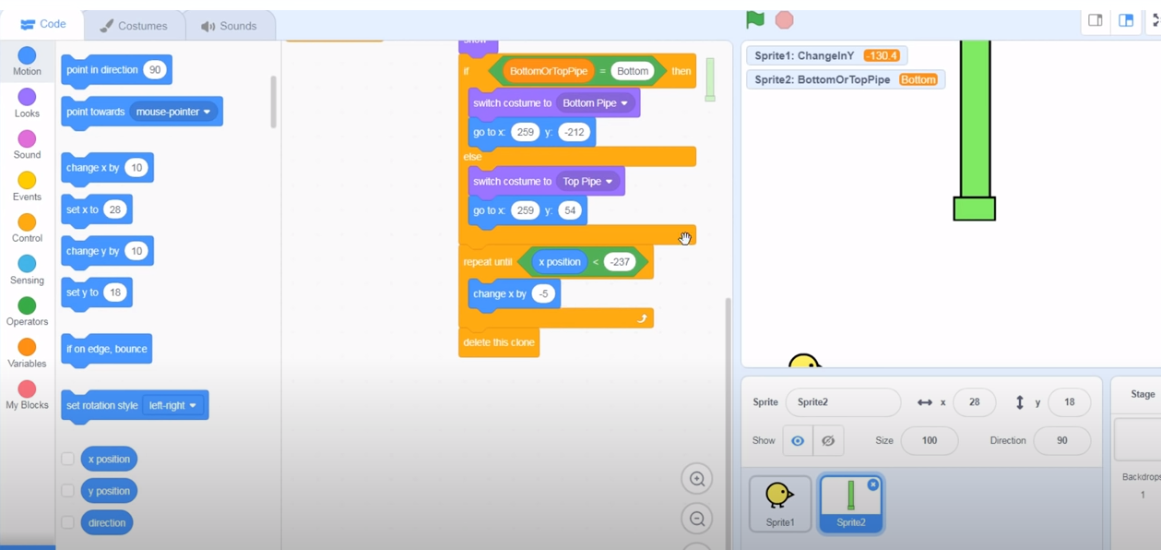
Now we want the pipes to move the left part of the screen

Slide 22
Test your work
Do the pipes move?
Do they disappear when they move from left to right?
Do they re-appear on the right?
Change the speed to (from 3 to 1)

Slide 23
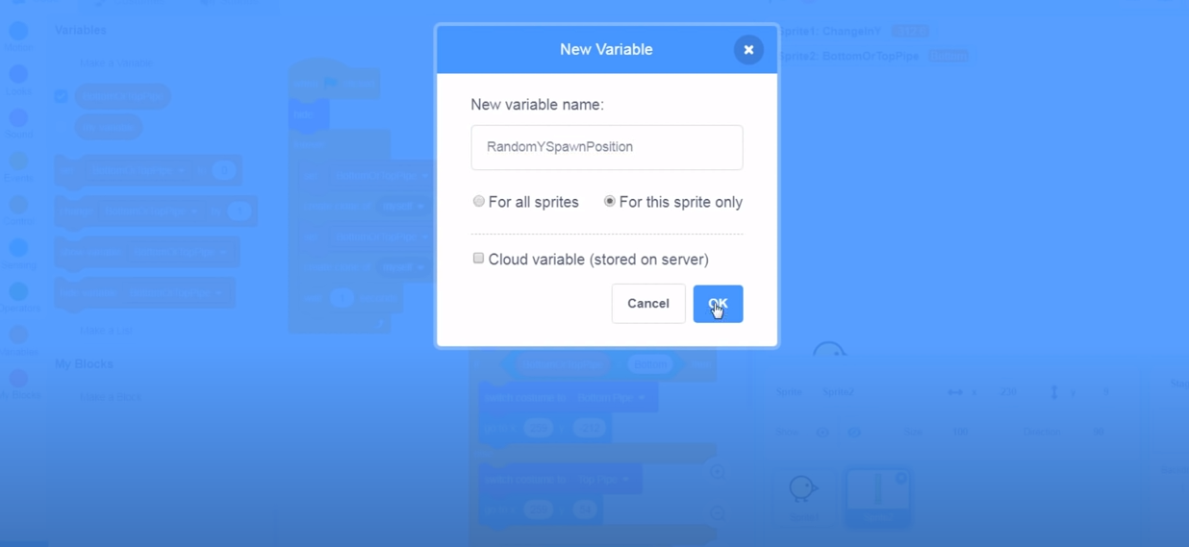
Create a new variable to spawn in the Y position

Slide 24
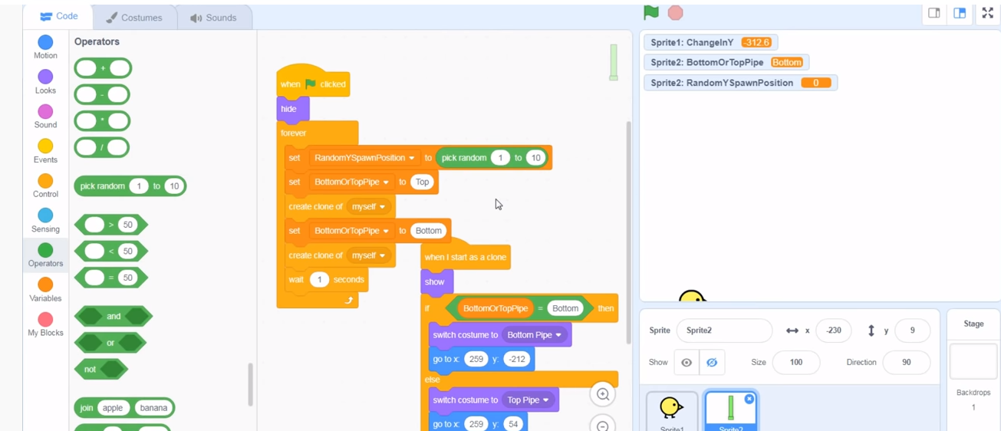
Code spawning

Slide 25
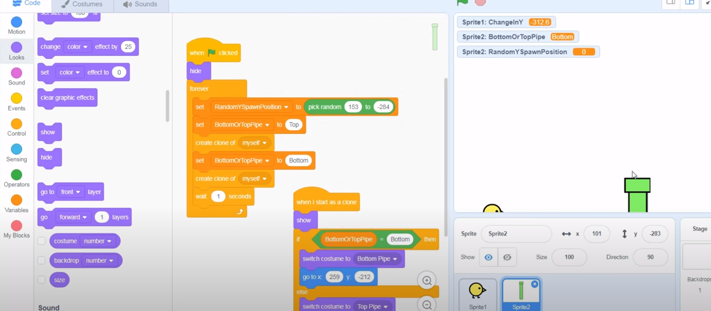
Set range of spawn – high and low

Slide 26
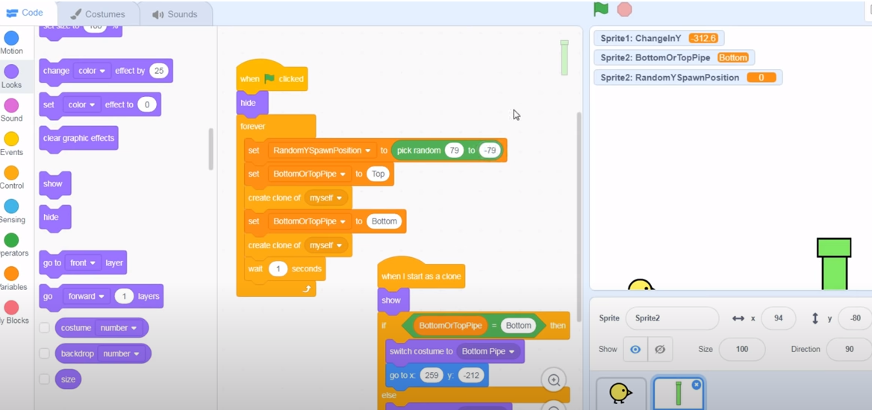
Change spacing

Slide 27
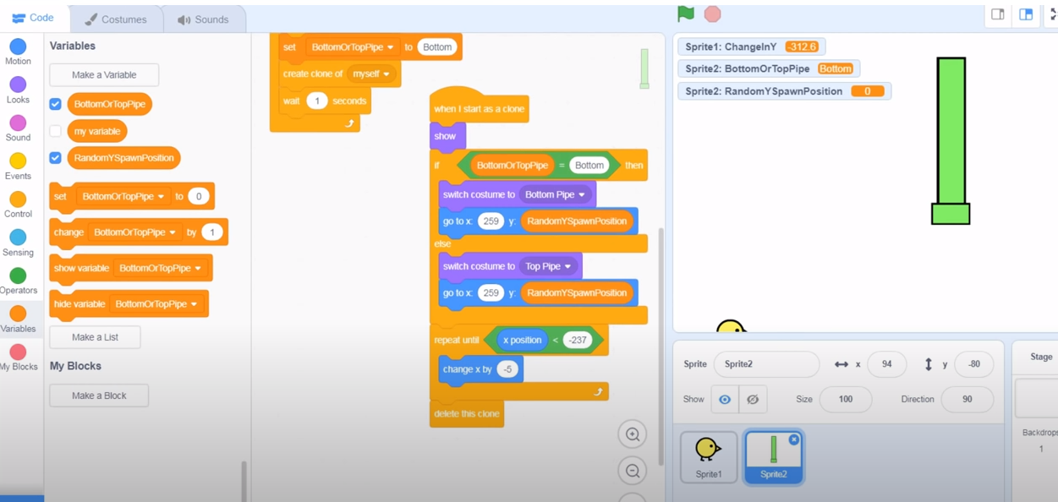
Update Pipe

Slide 28
Test your work
How do they pipes look?

Slide 29
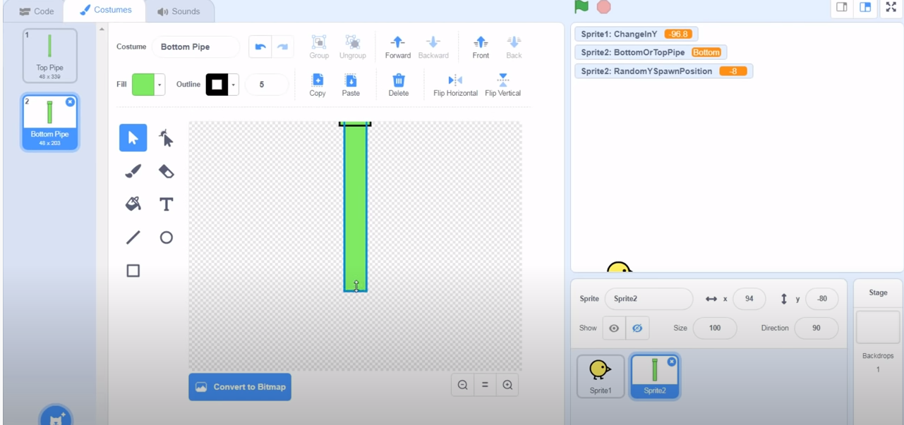
Increase length of Pipe if needed to correct display:

Slide 30
Test your work again
Verify gap – can bird get thru?
Spawning of pipes – are they random?
Does the bird size need to adjust?

Slide 31
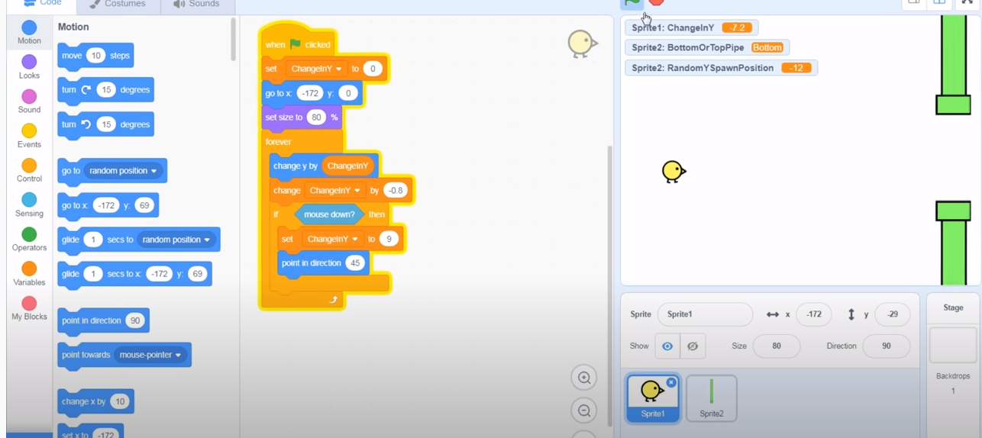
Make the bird rotate when it jumps

Slide 32
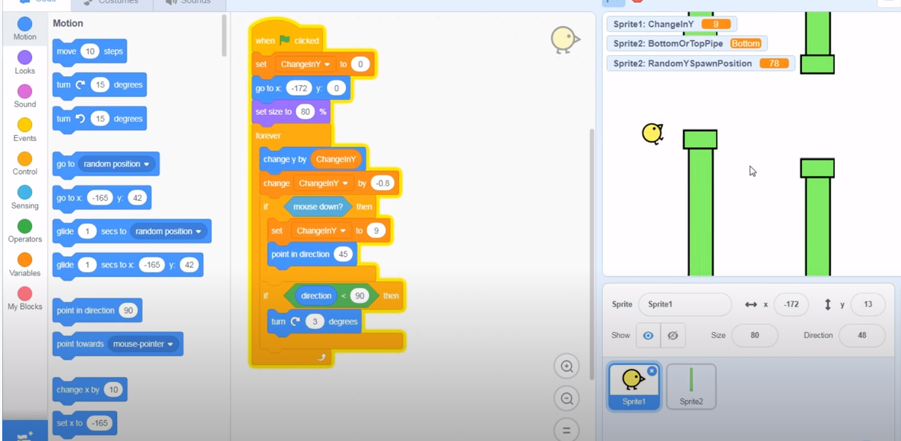
Correct direction – 4 degrees

Slide 33
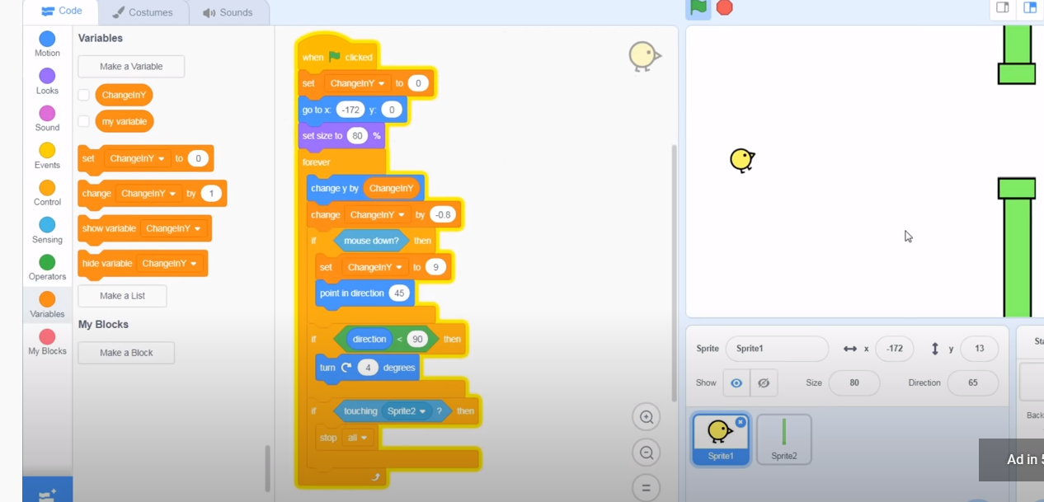
Make a simple lose condition

Slide 34
Hide your variables from display
(uncheck them)

Slide 35
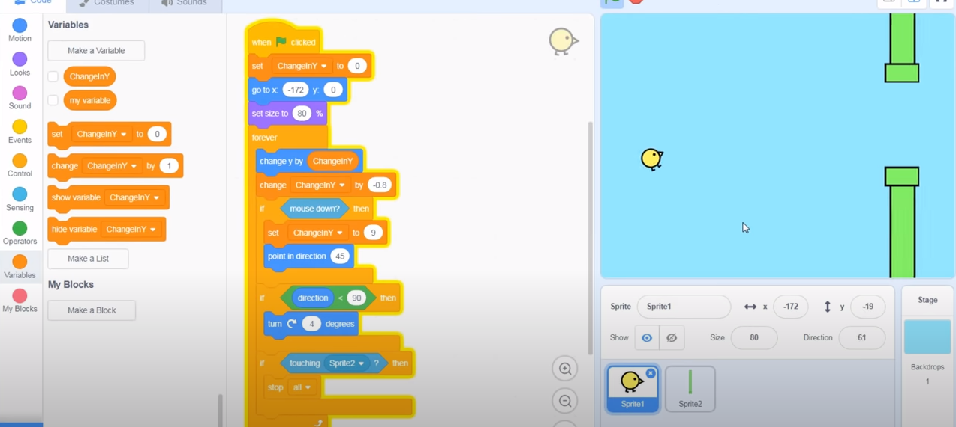
Add a backdrop – light blow

Slide 36
Let’s stop here and continue next week
Questions?

